Slide 1
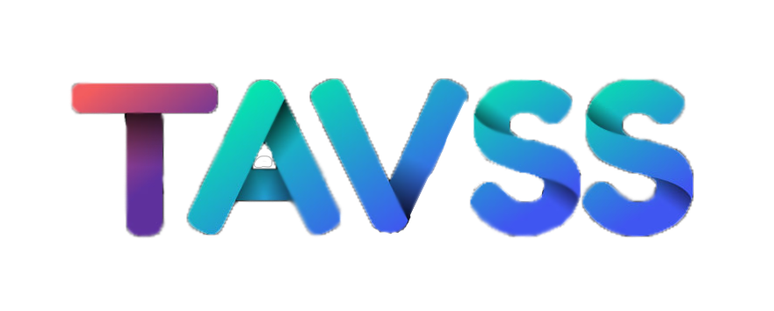




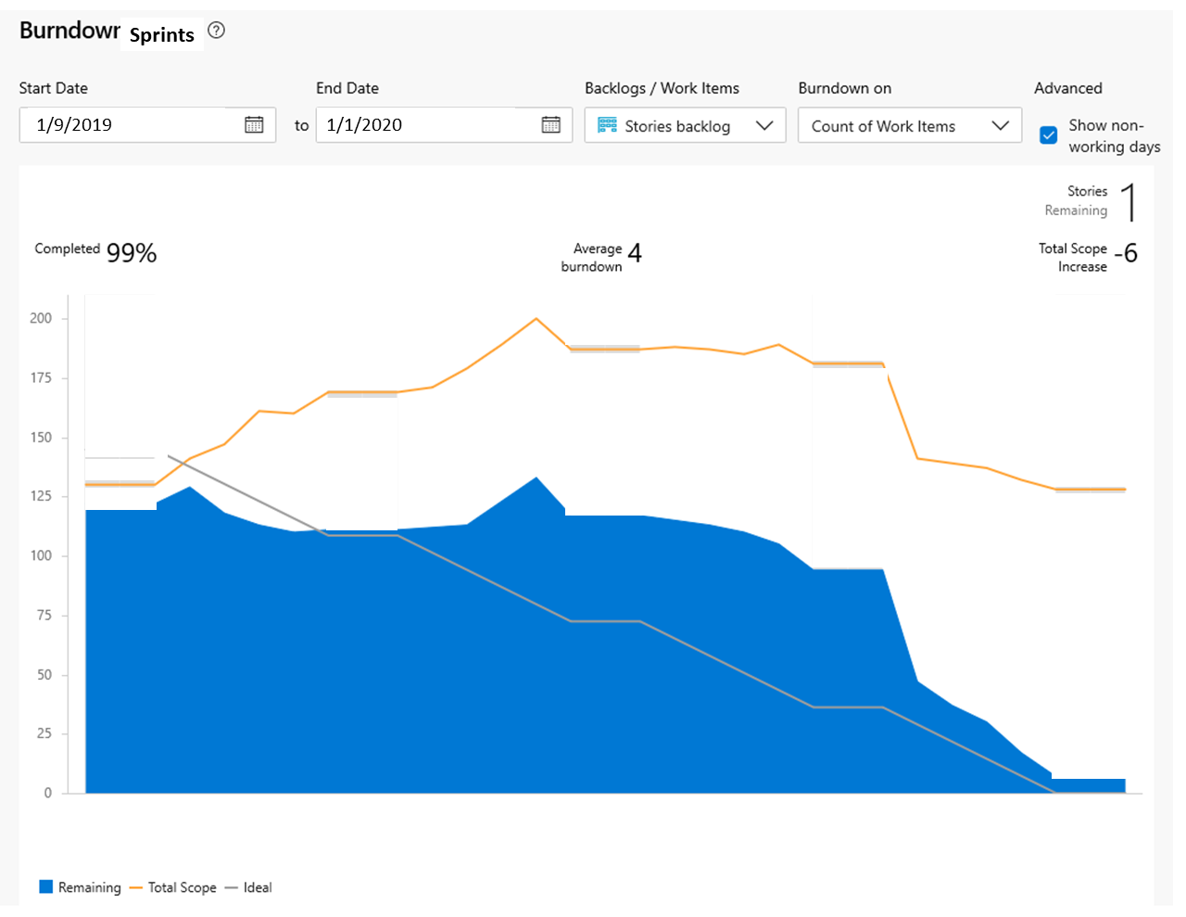
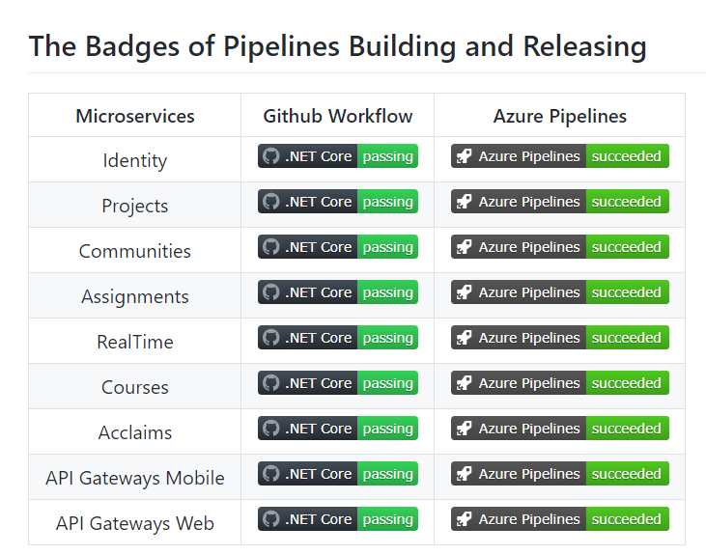
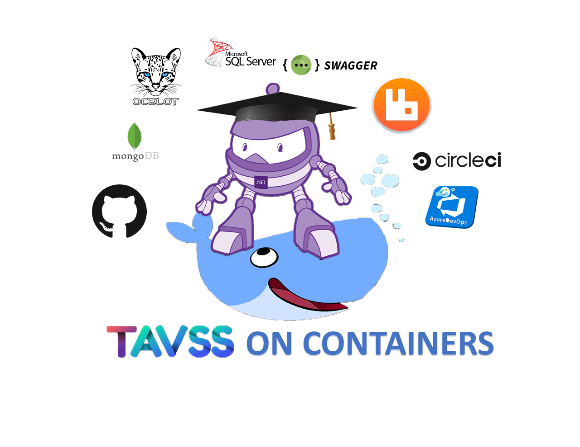
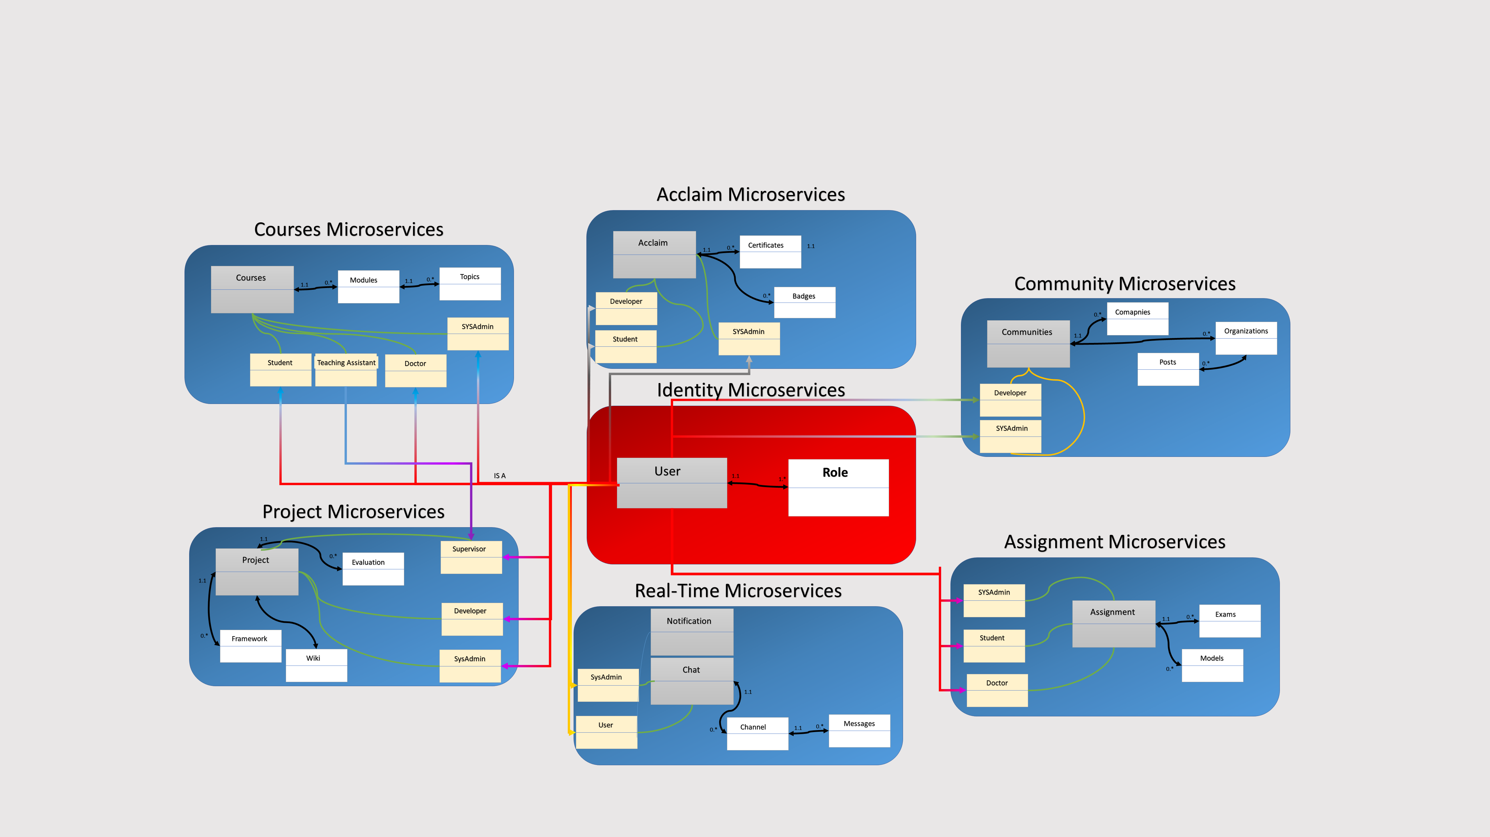
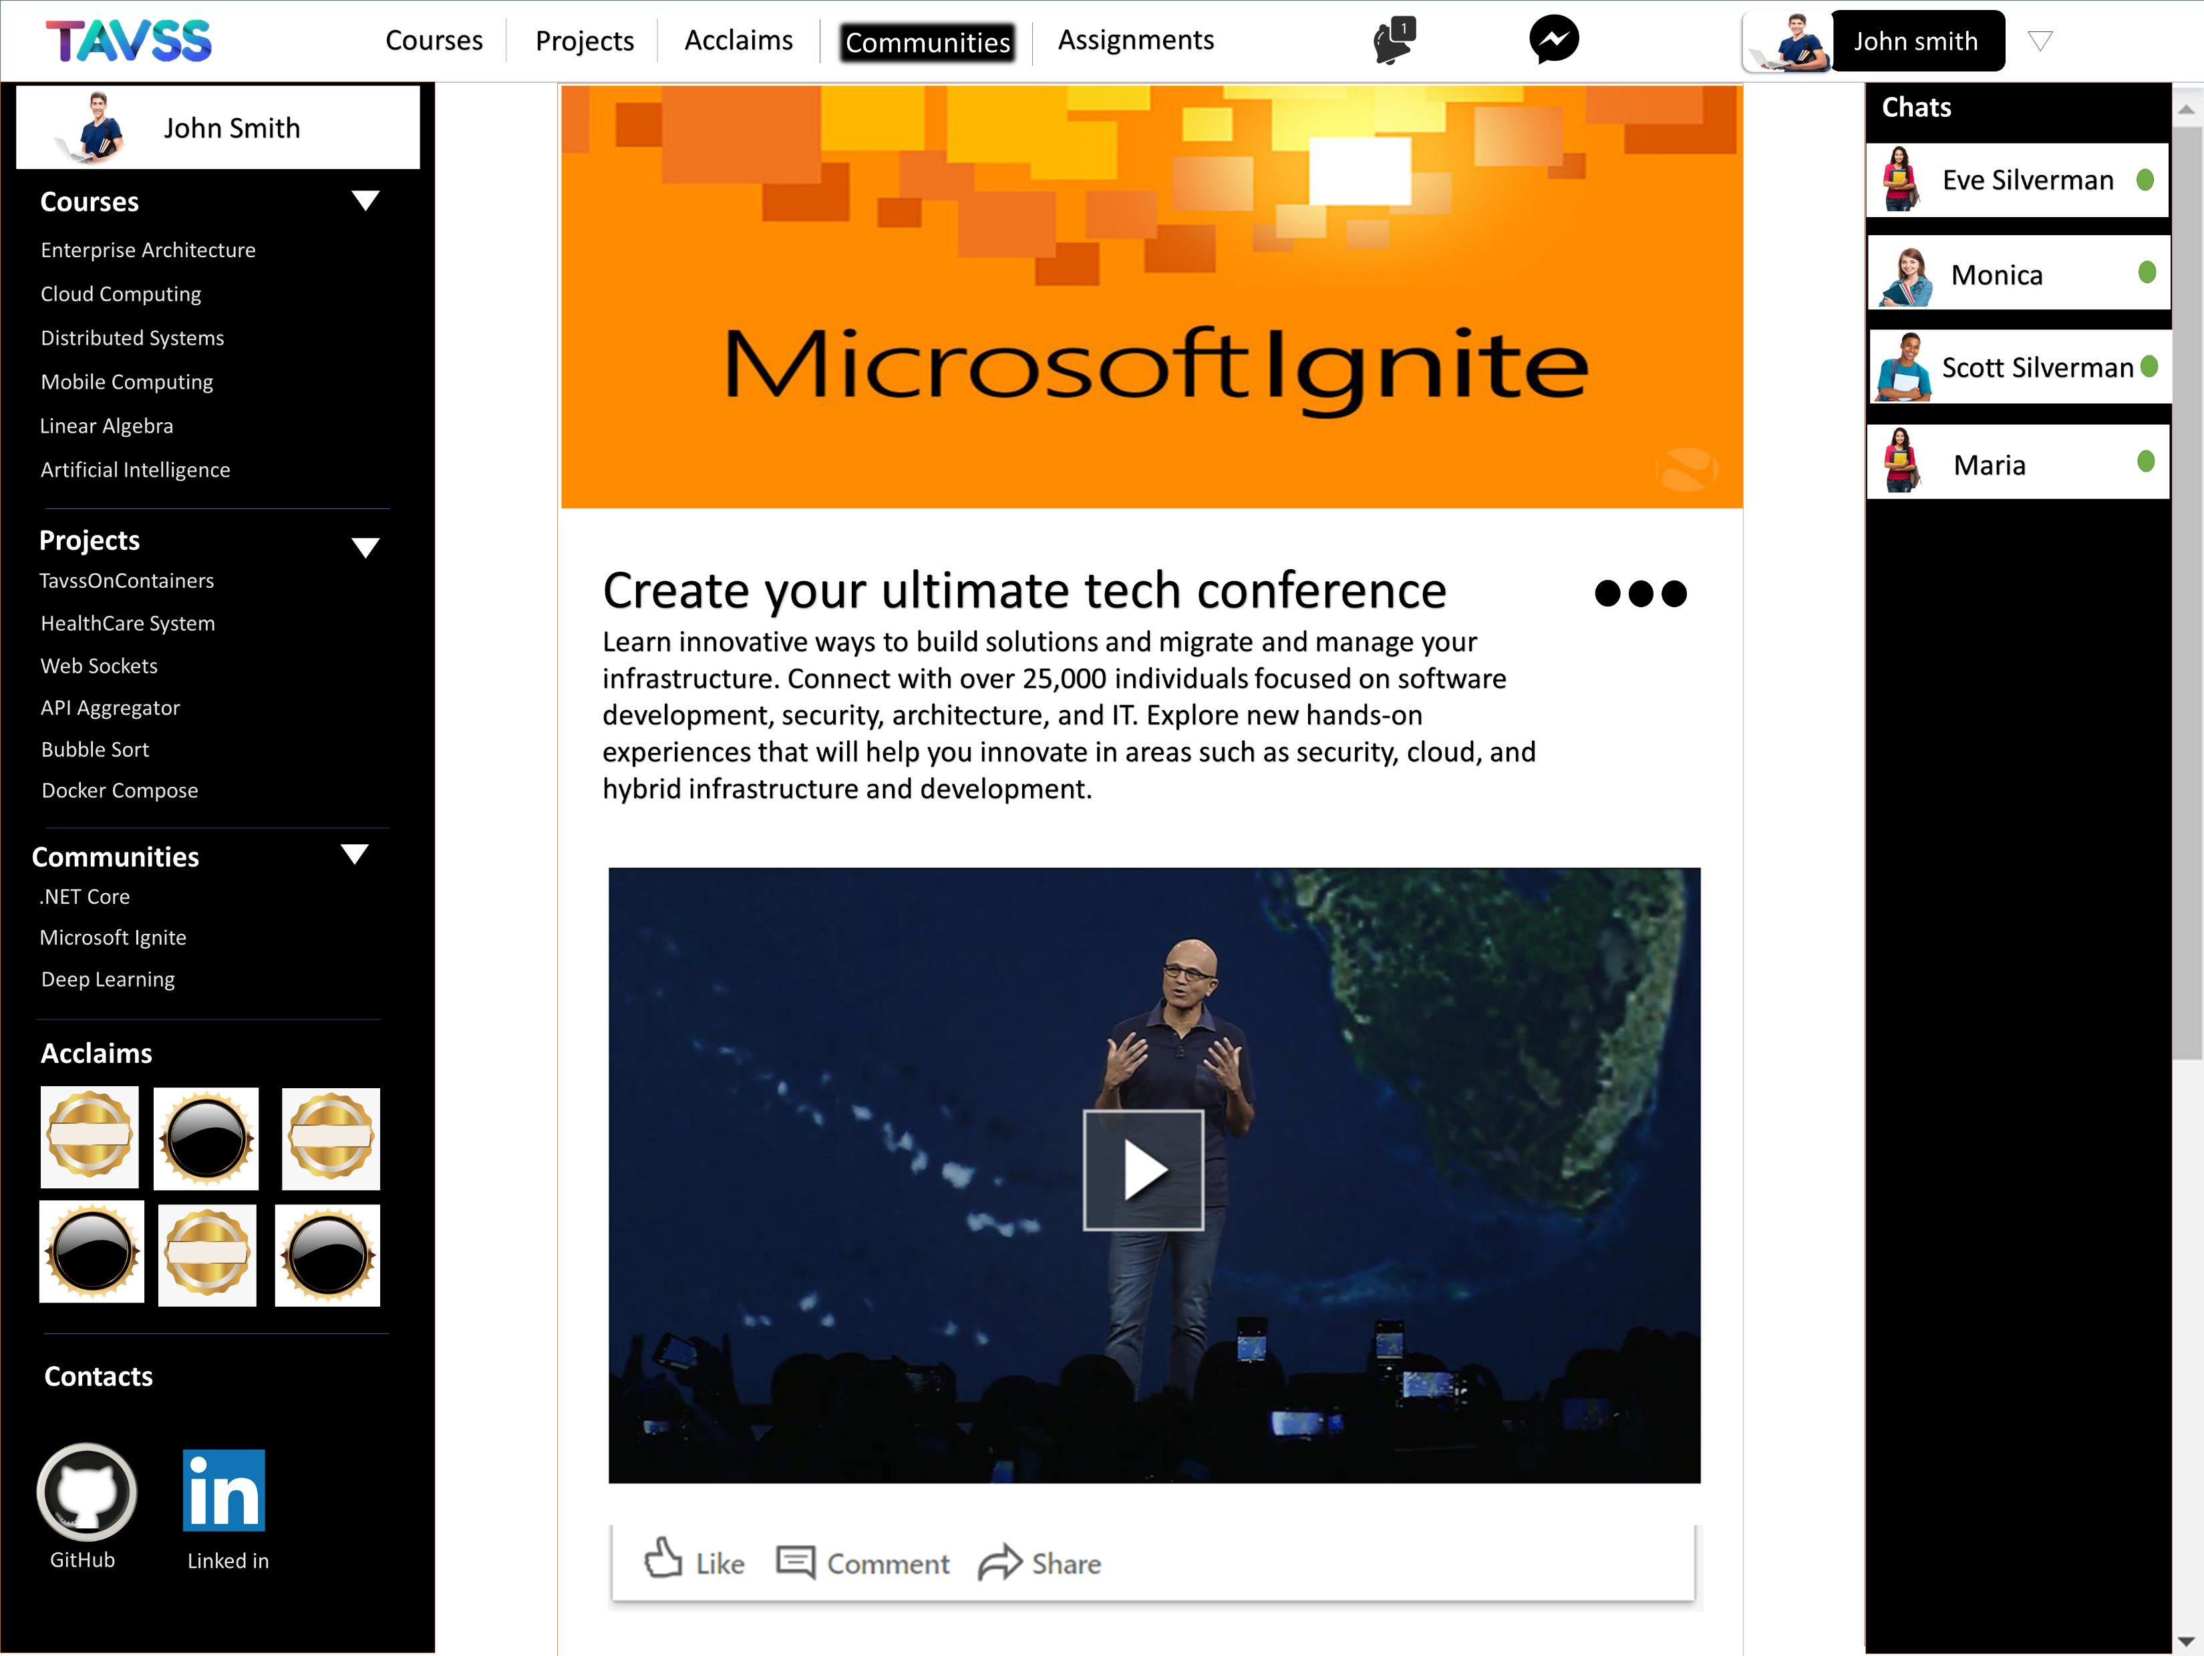
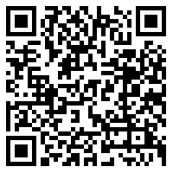



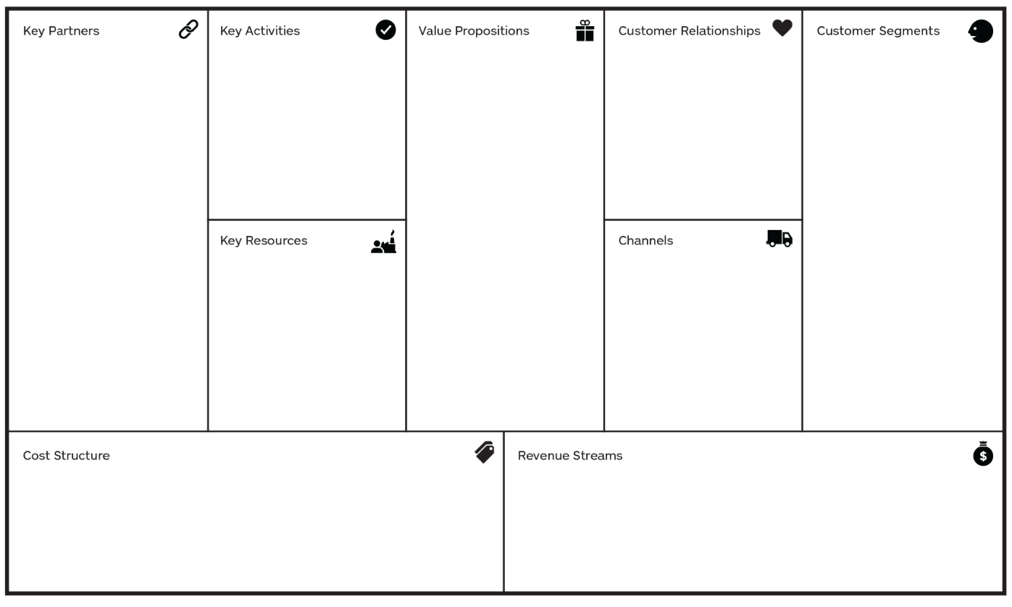
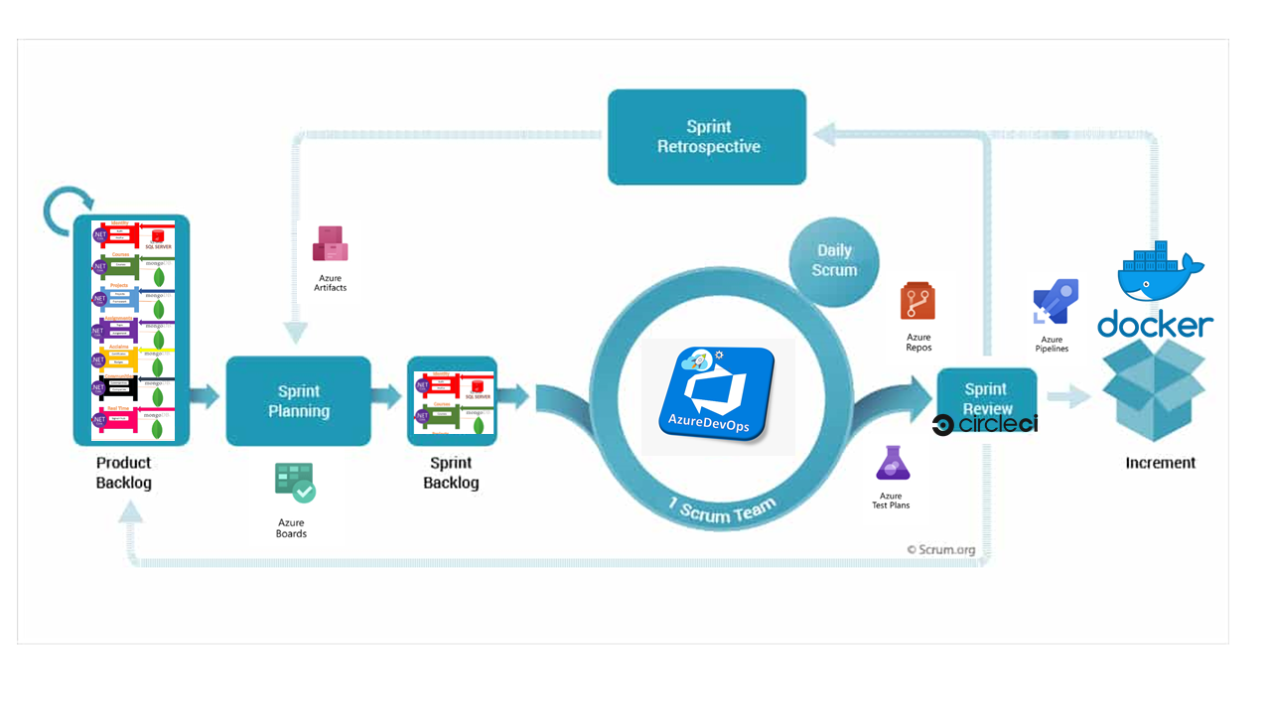
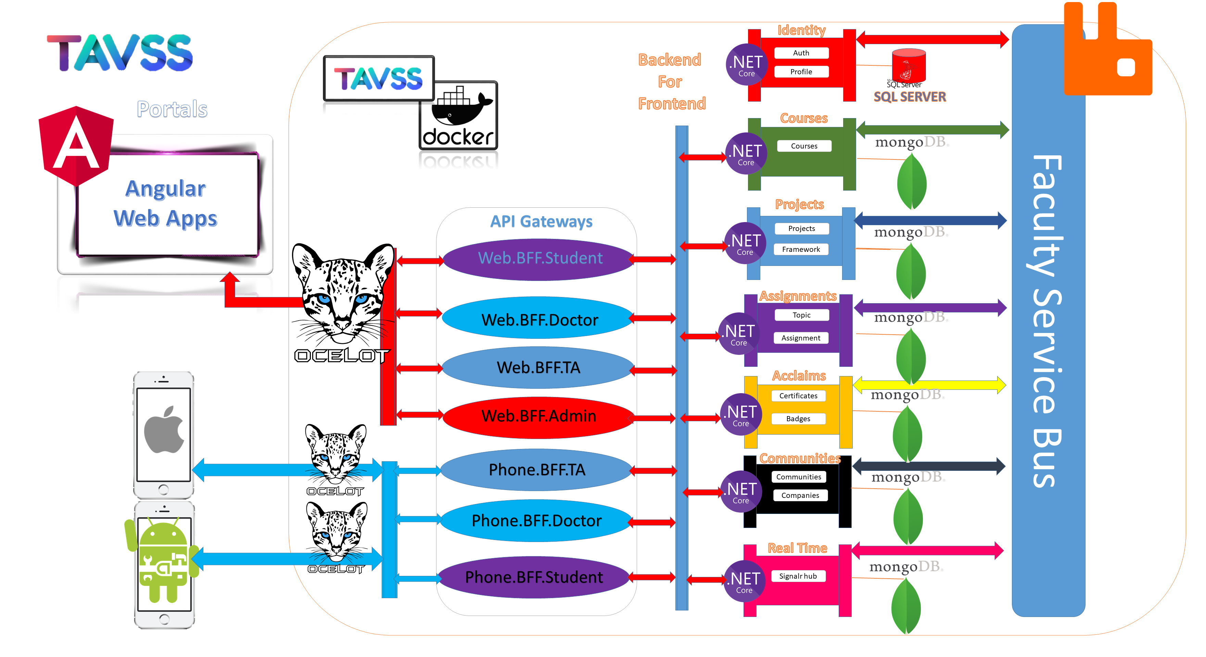
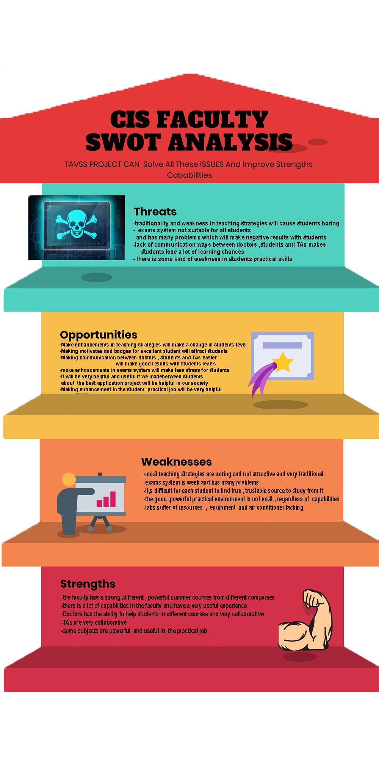
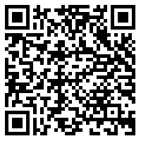
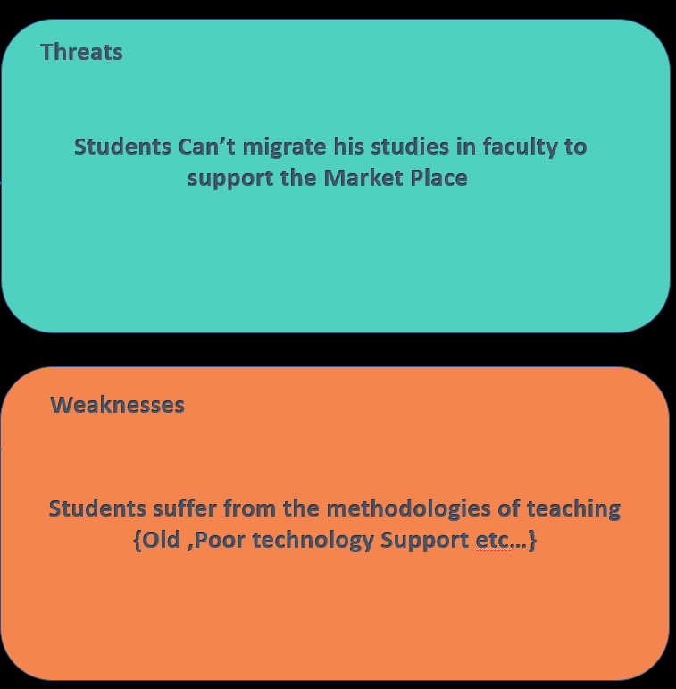
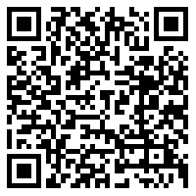
Abstract
READ MORE
e
RESULTS
READ MORE
IOS Developer
UI & UX designer
Ahmed Abu El-Regal
Heba Esmail
The Project is an application and architecture of how to use the Microservices Architecture to build an Interactive Learning services for students.
Applying different design patterns that can integrate any type of services or platforms or programming languages.
The business vision of the project takes the student into a lifecycle of 4 levels (Skills Building – Entertainment - Interaction – Career development) using Internal services integrated with External services.
Architecture is composed of internal and external services as components or small projects that interact with each other illustrated in the following conceptual model.
Android Developer
UI & UX designer
Islam Khater
Merna Osama
Android Developer
Frontend developer
Mohammad Anter
Teaching Assistant Versus Student Services
Noura Abd El-Naser
Backend Developer
Solution Architect
Frontend Developer
System Analyst
Mohammad Ashraf
Ahmed Khalil
Ahmed Abu Zahra
Rana Hesham
Microservice Interactive
Learning System
Supervisor : DR Samir Abd El-Razik
Consuming Microservices
Courses
Microservice
Communities
Microservice
Identity
Microservices
Conceptual Model
READ MORE
Background
The Traditional Monolithic systems have not the ability to sustain the learning systems, are not scalable enough to integrate new methodologies of learning from the external environments.
Accepting the Microservice architecture and the Agile processes to these environments make a new life for solving all the problems.
READ MORE
Microservice have the ability to merge and conquer all other systems; make the process of development very easy by divide the development teams to SCRUMS illustrating the process in the following figure.
System Architecture
Acclaims
Microservice
Project
Microservice
Real-Time
Microservices
READ MORE
READ MORE
Business Model/Cost
Faculty
Integration between faculties and companies
Ranking
Faculty
Platforms
Exams
Companies
Badges and Certifications
Notification
Companies
Microsoft
Architecture
Content Contribution
Web App
Students
Team Work
Mobile App
Doctors
Cloud Server
Development Tools
Devices
Company
Faculty
Objectives
READ MORE
Conclusions
Project Team
Microservices Gaining Know How
TAVSS join the external worlds with the faculty service bus and create a new life for every student to have a realistic learning techniques
Student Can’t migrate his studies in faculty to support Market Place
Faculty
Improving Teaching Techniques
The Market Place need more professional developers
Optimizing System Performance
Integrate External Services
Students Suffer from the methodologies of Teaching {Old , poor technologies}
Students
Connecting to work places
READ MORE
The Teaching staff have the powerful techniques to share info.
Challenging & interactive Learning

